Slide 1
The Srub Lords.
Done by: G8T4

Slide 2
Today’s Agenda
Schedule
Bug Metrics
Use of Git
Others

Slide 3
Schedule (Planned)
1
ACTUAL VS PLANNED SCHEDULE
Iteration 1 (Week 5 to 6): 17 Sept — 30 Oct
Iteration 2 (Week 7 to 8): 1 Oct — 14 Oct
Iteration 3 (Week 9 to 10): 15 Oct — 28 Oct
Iteration 4 (Week 11 to 12): 29 Oct to 11 Nov
Iteration 5 (Week 13 ): 12 Nov — 19 Nov
Front-End development for login and homepage
Implement Bootstrap feature
Create test cases and test login page
Update bug metrics
Creation of JSON, JSON Checker
Implement JSON Functionalities and validations
Implement of bidding features
Implement admin functionality
Run test cases and update bug metrics
Preparation for application demo and progress update
Implement clearing logic (Round 2) feature
Implement live bidding (Round 2) feature
Design Front-End for admin page
Create test cases for clearing logic & live bidding
Preparation for UAT
Refining existing website after UAT’s feedback
Implementation of additional requirements (if any)
Prepare for final presentation
Prepare for final presentation
Runthrough final presentation
Present on Final Presentation
Notes:
Visual representation of Actual Versus Planned Schedule in 2 or less readable slides. A timeline representation is sufficient here

Slide 4
Schedule (Actual)
1
ACTUAL VS PLANNED SCHEDULE
Iteration 1 (Week 5 to 6): 17 Sept — 30 Oct
Iteration 2 (Week 7 to 8): 1 Oct — 14 Oct
Iteration 3 (Week 9 to 10): 15 Oct — 28 Oct
Iteration 4 (Week 11 to 12): 29 Oct to 11 Nov
Iteration 5 (Week 13 ): 12 Nov — 19 Nov
Front-End development for login and homepage
Implement Bootstrap feature
Create test cases and test login page
Update bug metrics
Creation of JSON, JSON Checker
Implement JSON Functionalities and validations
Implement of bidding features
Implement admin functionality
Update bug metrics
Preparation for application demo and progress update
Create test cases and update bug metrics
Implement clearing logic (Round 2) feature
Implement live bidding (Round 2) feature
Design Front-End for admin page
Create test cases for clearing logic & live bidding and update bug metric
Preparation for UAT
Refining existing website after UAT’s feedback
Implementation of Bid Status (New)
Create test cases for bid status and update bug metics
Review and Update Test Plan
Prepare for final presentation
Implementation of additional requirements (if any)
Prepare for final presentation
Runthrough final presentation
Present on Final Presentation
Notes:
Visual representation of Actual Versus Planned Schedule in 2 or less readable slides. A timeline representation is sufficient here

Slide 5
Functionalities & Framework
1
DO YOU PLAN TO DROP/ADD ANY FUNCTIONALITIES AND
DO YOU USE ANY FRAMEWORKS OR EXTERNAL LIBRARIES?
No. We do not plan to drop/add any functionalities.
Yes. We are using BootStrap, an open-source CSS framework.
Notes:
Did you drop any functionalities, implement any additional functionalities, and/or use any frameworks or external libraries

Slide 6
Breakdown of Work
1
WAS ALLOCATION OF WORK FAIR?
Names | Programming Tasks | Non-Programming Tasks | Total Hours | %
Glen | Bootstrap Bid for a Section, Clearing Logic (Round 1, 2) Dump Table, Bid, User, Section Update and Delete Bid Bid Status | Scheduling (PM - Iteration 1) Daily Updates (PM - Iteration 1) Bug Metric | 344.25 | 28.4
Mary | Bootstrap Test Cases | Scheduling (PM - Iteration 2) Daily Updates (PM - Iteration 2) Slides | 269.25 | 22.2
Agnes | View Bidding Results Start/Stop Round UI (Student and Admin Pages) View Dump Table, Bid, User, Section | Scheduling (PM - Iteration 3) Daily Updates (PM - Iteration 3) Slides | 226.5 | 18.7
Shourya | Test Cases Login Function Dump Functions Rectifications | Scheduling (PM - Iteration 4) Daily Updates (PM - Iteration 4) Meeting Minutes Test Plan | 153 | 12.7
Kwan Yang | Authenticate Clearing Logic (Round 2) Test Cases | Scheduling (PM - Iteration 5) Daily Updates (PM - Iteration 5) Slides | 215.5 | 18.0
Notes:
Visual representation of Actual Versus Planned Schedule in 2 or less readable slides. A timeline representation is sufficient here.
Did you drop any functionalities, implement any additional functionalities, and/or use any frameworks or external libraries? If so what.
Show us your breakdown of work. Separate the programming tasks from the non-programming tasks. For programming tasks, show us the task allocation as well as the hours spent by each team member. Explain why your work allocation was fair. Show us absolute numbers as well as percentages.
Tell us about the problems you faced tracking your schedule and how you overcame them.

Slide 7
Problems Faced
1
Problems faced when tracking our schedule and how we overcame them
Challenges Faced | How did we overcome them?
Pushed back creating test cases (json_checker) in Iteration 2 due to time constraint | PM scheduled another pair programming (test cases) session in Iteration 3.
Additional functional requirement from client in Iteration 3 | Use pre-allocated time to hold additional pair programming and debugging session in Iteration 4
Notes:
Tell us about the problems you faced tracking your schedule and how you overcame them.

Slide 8
Bug Metrics
2
CALCULATION OF IMPACT SCORE & MITIGATION PLAN
Calculation of Impact Score
Severity |  |  | Description
Low Impact (Score = 1) |  |  | Inconsequential. Simple typo error or minor user interface misalignment
High Impact (Score = 5) |  |  | Non-critical functionalities are not working, but the system still runs
Critical Impact (Score = 10) |  |  | The system or core functionality is down. Immediate attention is required
Mitigation Plan
Points in Iteration |  |  | Action
Points < 10 |  |  | Use the planned debugging time in the iteration.
Points ≥ 10 |  |  | Stop current development and resolve the bug immediately. Project Manager reschedules the project.
Notes:
Show us a visual representation for the metric that shows the values of the metric over time.
Tell us how you used the metric to fix problems identified.
Give us examples of concrete follow-on actions you took to fix the most severe problems identified by the metric.
What were some of the challenges faced (and how you overcame them) when collecting and using the metric?

Slide 9
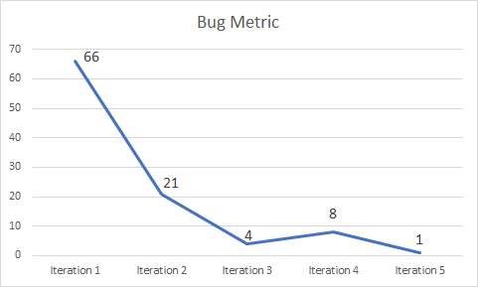
Bug Metrics
2
VALUES OF METRICS OVER TIME
Iteration | Bug Metrics | Mitigation
Iteration 1 | 66 | Stop current development and resolve the bug immediately. Project Manager reschedules the project.
Iteration 2 | 21 | Use the planned debugging time in the iteration.
Iteration 3 | 4 | Use the planned debugging time in the iteration.
Iteration 4 | 8 | Use the planned debugging time in the iteration.
Iteration 5 | 1 | Use the planned debugging time in the iteration.
Notes:
Show us a visual representation for the metric that shows the values of the metric over time.
Tell us how you used the metric to fix problems identified.
Give us examples of concrete follow-on actions you took to fix the most severe problems identified by the metric.
What were some of the challenges faced (and how you overcame them) when collecting and using the metric?

Slide 10
Problems Identified
2
HOW DID WE USE THE METRICS TO FIX THE PROBLEMS IDENTIFIED?
We identified the most number of bugs (n= 66) in Iteration 1.
According to the metrics, we had to stop current development and resolve the issues at hand, immediately. Our PM had to re-adjust the project timeline because we needed more time to debug and solve the bugs.
Notes:
Show us a visual representation for the metric that shows the values of the metric over time.
Tell us how you used the metric to fix problems identified.
Give us examples of concrete follow-on actions you took to fix the most severe problems identified by the metric.
What were some of the challenges faced (and how you overcame them) when collecting and using the metric?

Slide 11
Follow-up Actions
2
CONCRETE FOLLOW-UP ACTIONS TAKEN TO FIX MOST SEVERE PROBLEMS IDENTIFIED BY THE METRIC
Function | Description | Severity | Follow-Up Actions
Login | Upon entering a successful/unsuccessful username/password in the website leads to a blank page | Critical, 10 | The system is down or is unusable after a short period of time. We have to fix the bugs to continue.
Bootstrap | Uploading the file on bootstrap.php shows a blank page | Critical, 10 | The system is down or is unusable after a short period of time. We have to fix the bugs to continue.
Notes:
Show us a visual representation for the metric that shows the values of the metric over time.
Tell us how you used the metric to fix problems identified.
Give us examples of concrete follow-on actions you took to fix the most severe problems identified by the metric.
What were some of the challenges faced (and how you overcame them) when collecting and using the metric?

Slide 12
Challenges Faced
2
CHALLENGES FACED & HOW WE OVERCAME THEM WHEN COLLECTING AND USING THE BUG METRICS
Challenges Faced | How did we overcome them?
When focused on fixing the bugs, we tend to forget to record the bugs on the bug log | Since we usually find bugs during the PP session and doing test cases, we are always accompanied with a group member and thus, we would remind each other to record the bugs found in the bug log.
Notes:
Show us a visual representation for the metric that shows the values of the metric over time.
Tell us how you used the metric to fix problems identified.
Give us examples of concrete follow-on actions you took to fix the most severe problems identified by the metric.
What were some of the challenges faced (and how you overcame them) when collecting and using the metric?

Slide 13
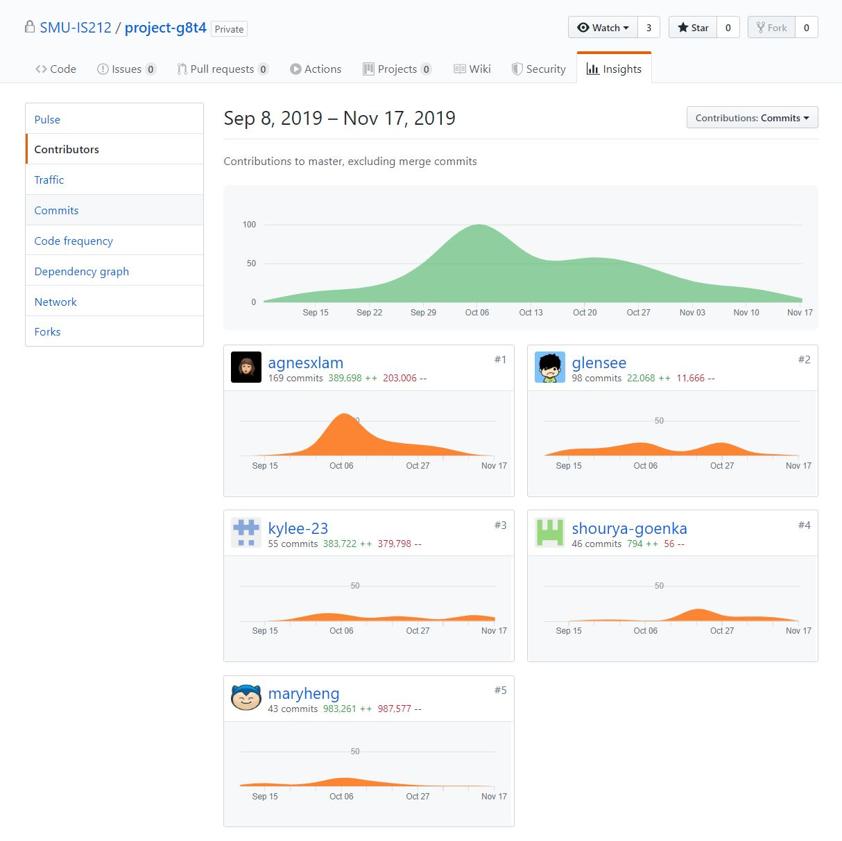
Use of Git
3
GitHub Snapshots
Notes:
Demonstrate to us that you used Git consistently, correctly, and evenly (across your entire team). You should use data (in nice graphical forms) from your commit logs, commit histories to substantiate your claims.

Slide 14
Others
4
MAIN TAKEAWAYS FROM SOFTWARE PROJECT MANAGEMENT
Lessons Learnt and Key Takeaway
For the group, it has been challenging to follow closely to the schedule because all of us have our own individual commitments and projects that would take priority. We also realised that planning is also an integral part of task completion. However, looking back from this experience, the main takeaway would be the importance of communication and the need to work as a group to accomplish all the requirements.
Notes:
Tell us what are the main takeaways you have gained from doing the project?

Slide 15
Others
4
TEAM CONFLICTS AND HOW DID WE SOLVE IT?
Not actively participating. As a group, we consulted the prof for his advice and tried to heed his advice.
Notes:
Any team conflicts/issues/problems and how your team resolved it. Be sensitive.

Slide 16
Others
4
INTERESTING THINGS ABOUT EACH OTHER THAT WE DID NOT KNOW BEFORE SPM
Glen really loves coke zero
Kwan Yang is a 6 mod dude
Agnes always has snacks/sweets in her bag
Shourya tanked BPAS presentation
Mary is a tehpeng lover
Notes:
Something particularly interesting about your team members that you did not know before SPM.

Slide 17
Thank you.
Done by: G8T4

